Slide 1
Search Engine for Text Documents
Supervisor: Eng/ Esraa Maged

Slide 2
Team Members
Kareem Abdel-Muttalib
Mohamed Magdy
Hossam Nasr
Ahmed Moustafa
Salma Yasser
Ola Farhat

Slide 3
Table of contents
Introduction & Project Overview
Technologies, Tools & Features
01.
02.
Core Modules & Logic
Demo & Output
03.
04.

Slide 4
Introduction & Project Overview
01.

Slide 5
Introduction
Search engines play a vital role in helping users find relevant information in large text collections. This project explores how a search engine works by building a simplified version focused on document retrieval. It combines core natural language processing techniques with efficient indexing and ranking methods. The goal is to offer accurate, ranked results for a user's query. By handling everything from preprocessing to result display, this project demonstrates how search technology can be applied using basic tools and algorithms.

Slide 6
Project Overview
The project is built using Python and organized into four main modules: preprocessing, indexing, retrieval, and a user interface. Text documents are cleaned and tokenized before being indexed using techniques like the Document-Term Matrix, Inverted Index, and TF-IDF. When a user enters a query, the engine ranks documents using cosine similarity and displays the results through a Streamlit web app. The modular design makes it easy to understand each part of the pipeline while showcasing the practical use of NLP and information retrieval in real applications.

Slide 7
Technologies, Tools & Features
02.

Slide 8
Languages & Frameworks
Dataset
Libraries
Course materials from the IS Strategy class used as the searchable document collection.
Python, Streamlit
NLTK, NumPy, scikit-learn,streamlit, etc.

Slide 9
Key Features
Clean and interactive UI with Streamlit
4
1
Preprocessing with NLP
3
2
Ranked search using Cosine Similarity
Multiple indexing methods (Inverted Index, TF-IDF)

Slide 10
Core Modules & Logic
03.

Slide 11
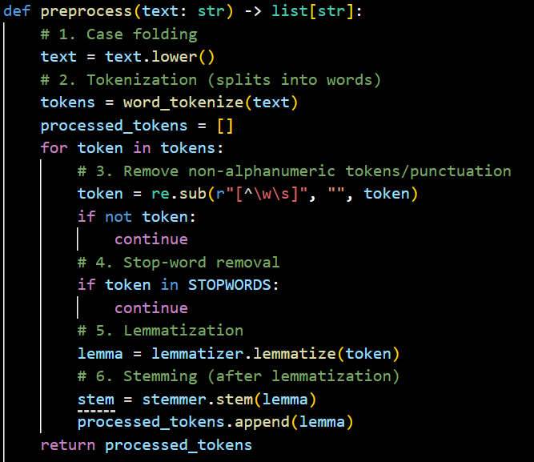
Preprocessing

Slide 12
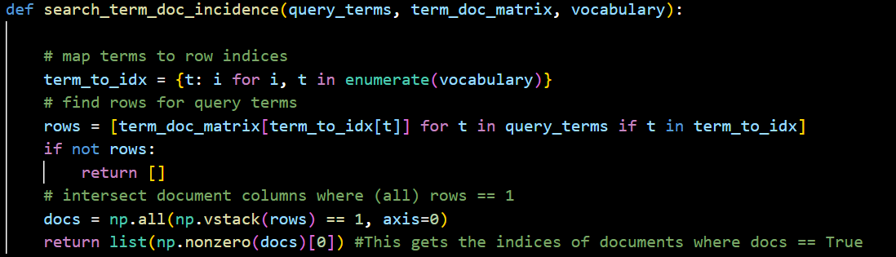
Search term_doc_incidence

Slide 13
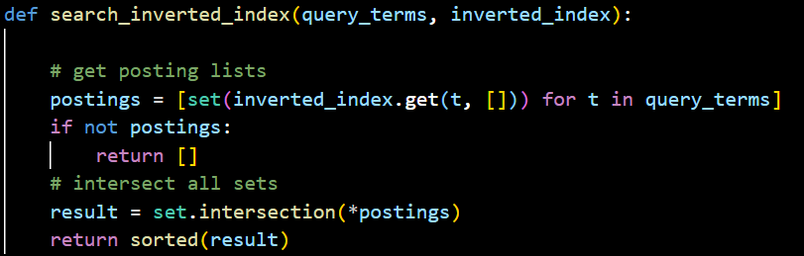
Search inverted_index

Slide 14
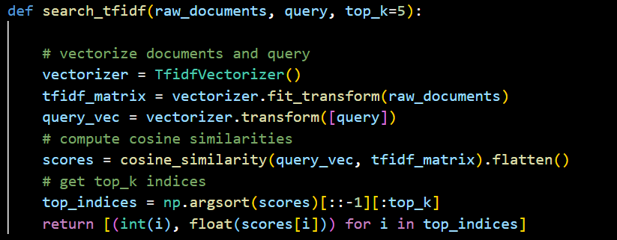
Search tfidf

Slide 15
Demo & Output
04.

Slide 16
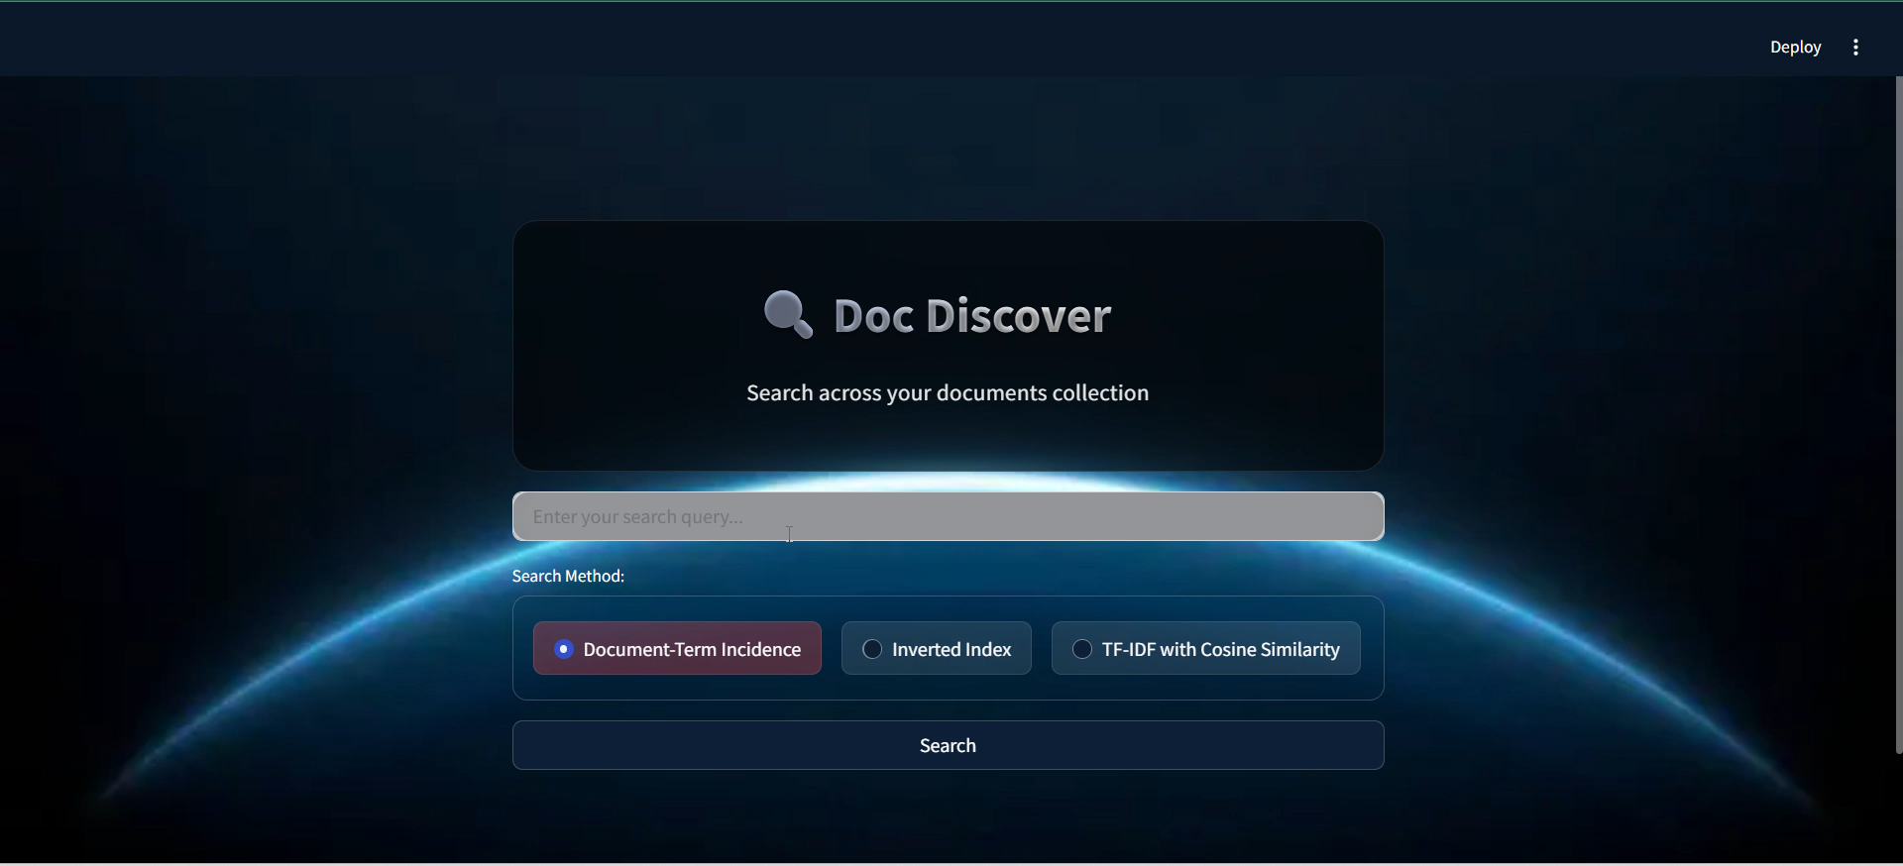

Slide 17
Thanks!

